Slide 1
TODAY'S AGENDA
Introduction of Presenter
Office of Vocational Rehabilitation (OVR) Overview
Pre-Employment Transition Services
(Pre-ETS) Program
Pre-ETS Programs Overview & Breakdown
Eligibility Criteria
Basic Support/Supported Employment
Overview Process
Eligibility Criteria
Services to Individuals and Employers
Open Forum
Contact Information
TOGETHER WE CAN BUILD A FUTURE.
THE CNMI OFFICE OF THE GOVERNOR
OFFICE OF VOCATIONAL
REHABILITATION

Slide 2
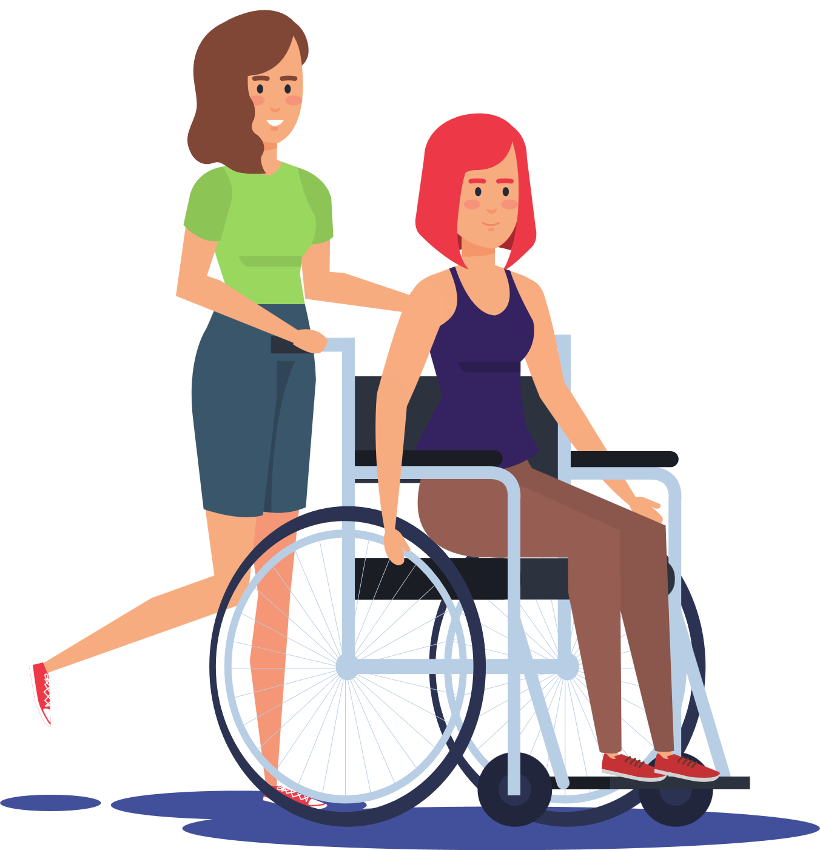
OFFICE OF THE GOVERNOR
OFFICE OF VOCATIONAL
REHABILITATION
TRANSITION
SERVICES
SAMUEL DAVID F. SANTOS
OVR Transition Specialist
TOGETHER
WE CAN BUILD
A FUTURE

Slide 3
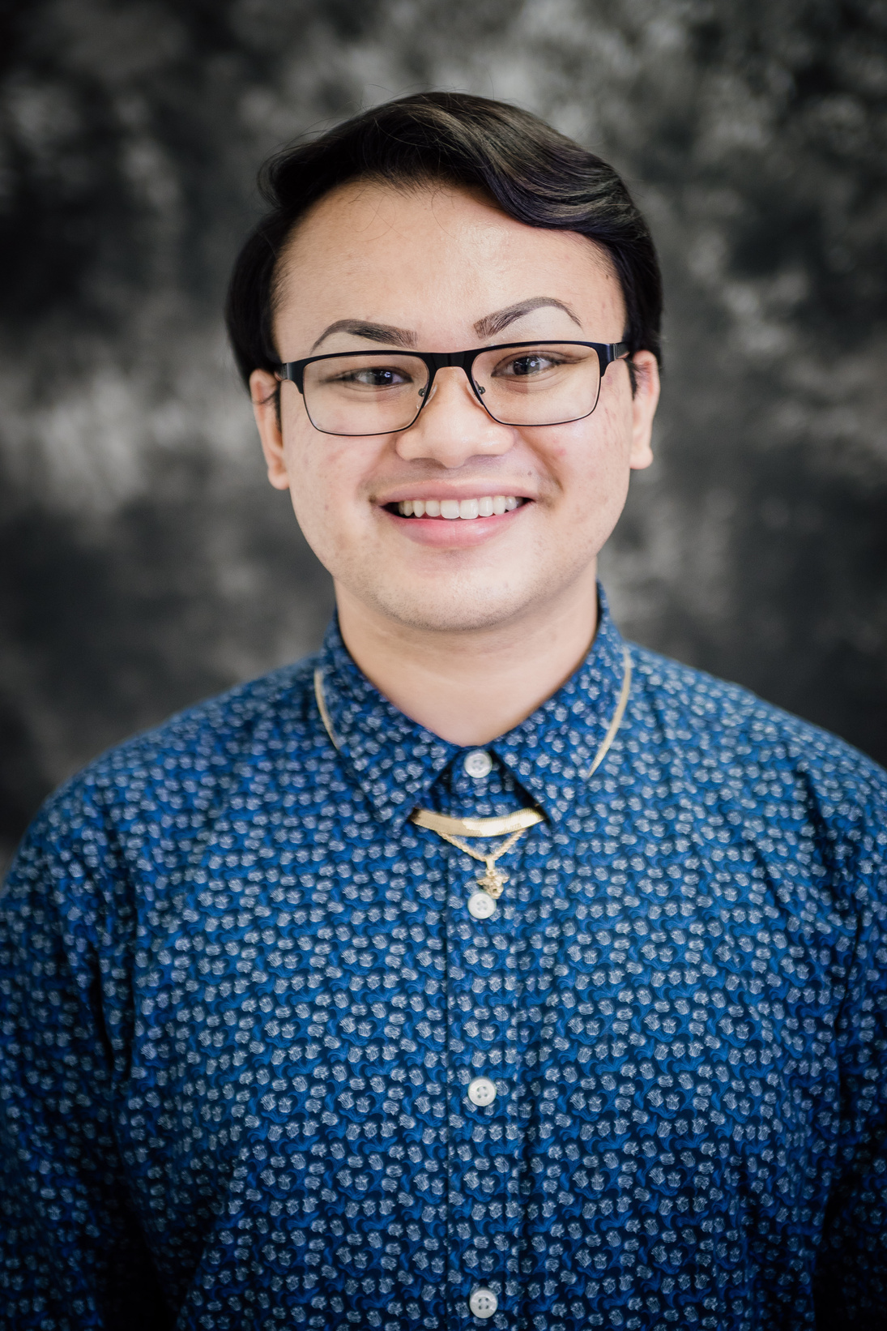
TOGETHER WE CAN BUILD A FUTURE
Today's Presenter:
SAM SANTOS
Office of Vocational Rehabilitation Transition Specialist
Northern Marianas College
School of Education:
Rehabilitation and Human Services
Special Education Teacher Aide (Marianas High School: 2015-2021)

Slide 4
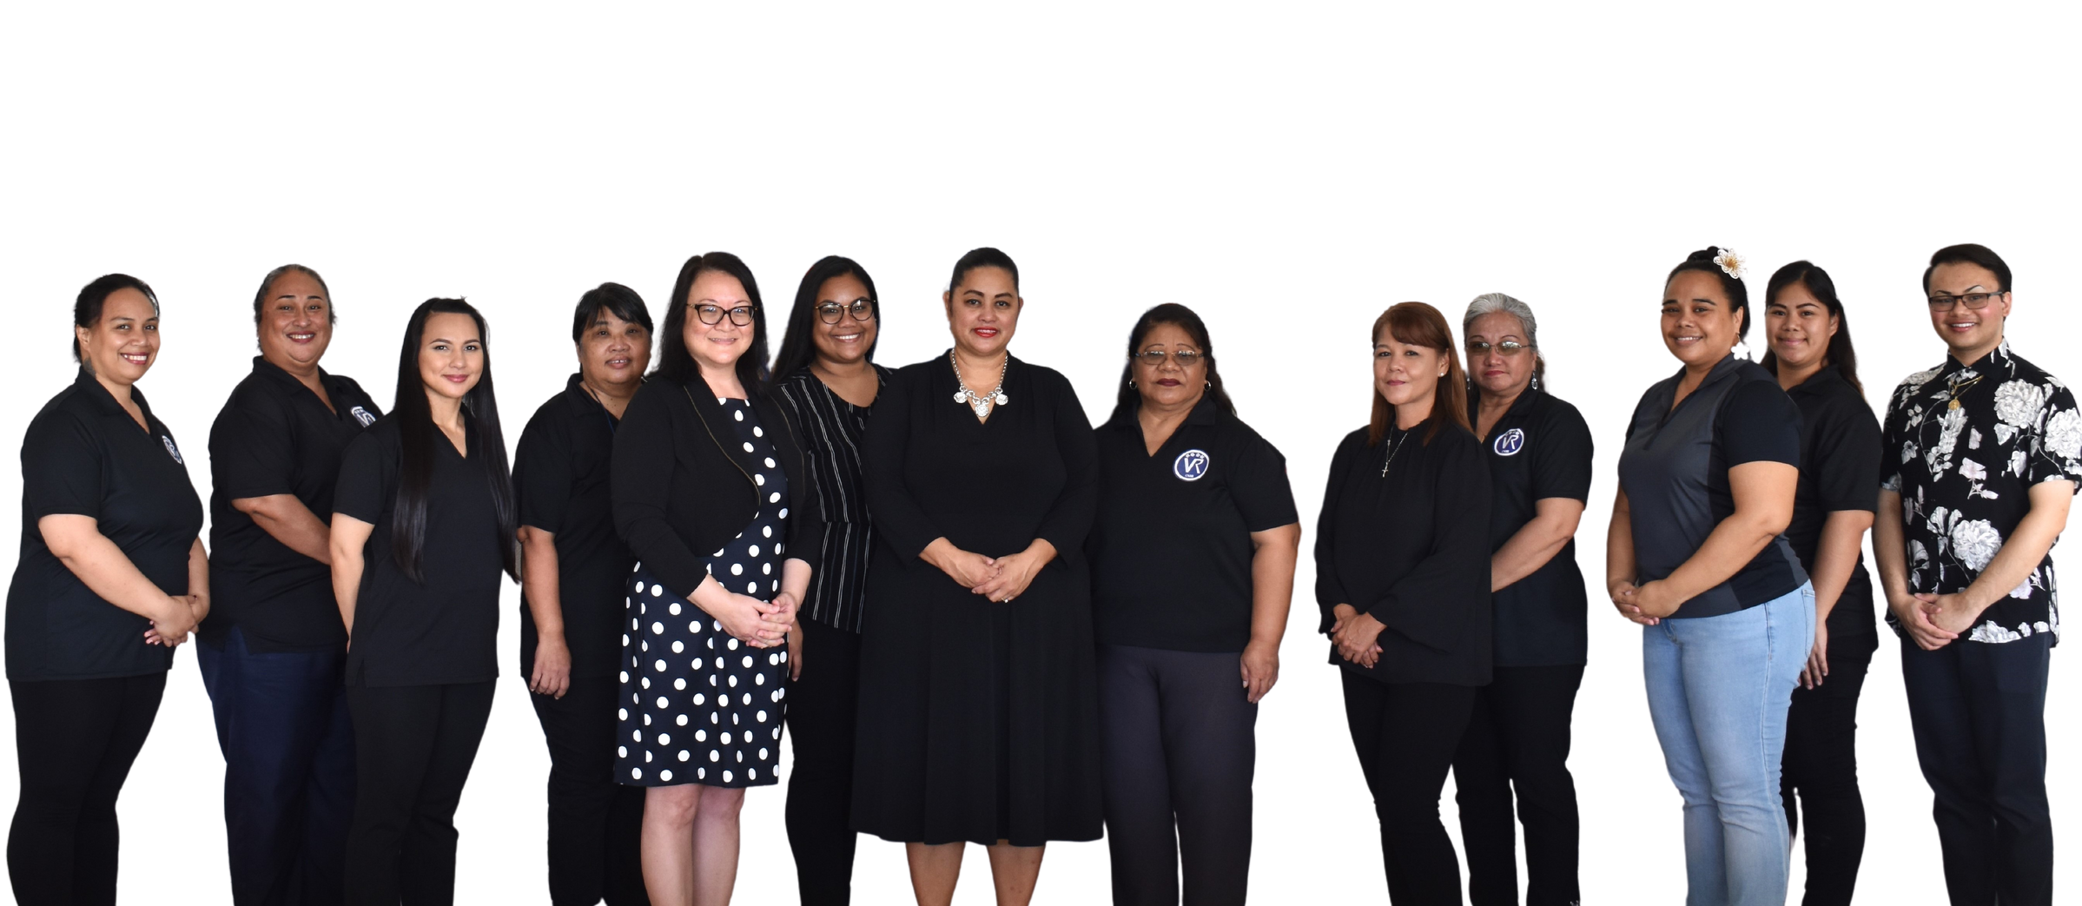
TOGETHER WE CAN BUILD A FUTURE.
WHO ARE WE?
Established in 1975, OVR is a state and federal partnership agency, placed within the Office of the Governor, that provides services to individuals with disabilities throughout the CNMI.

Slide 5
OUR MISSION
To INCREASE employment and promote independence among eligible individuals with disabilities throughout the CNMI.
TOGETHER WE CAN BUILD A FUTURE

Slide 6
OUR VISION
That individuals with disabilities are:
EMPLOYED in competitive and integrated work settings
EMPOWERED to make qualified decisions and informed choices
ECONOMICALLY self-sufficient
TOGETHER WE CAN BUILD A FUTURE

Slide 7
WHAT IS IT?
2014 LEGISLATION designed to help individuals, especially those with disabilities land and retain employment
WORKFORCE
INNOVATIVE
OPPORTUNITY
ACT (WIOA)
HOW?
OVR fulfills this by providing core and intensive services to meet WIOA's goals.
THUS,
TOGETHER WE CAN BUILD A FUTURE
The Office of Vocational Rehabilitation is funded under the Title IV of the 2014 WIOA.

Slide 8
TOGETHER WE CAN BUILD A FUTURE
PRE-EMPLOYMENT
TRANSITION
SERVICES (Pre-ETS)
A program under WIOA (2014) that seeks to provide services to help students who want to work to become prepared for life after high school and have meaningful careers through training, continuing education, or finding a job through various activities.
Its ultimate goal is to help students transition to be career and/or college-ready.

Slide 9
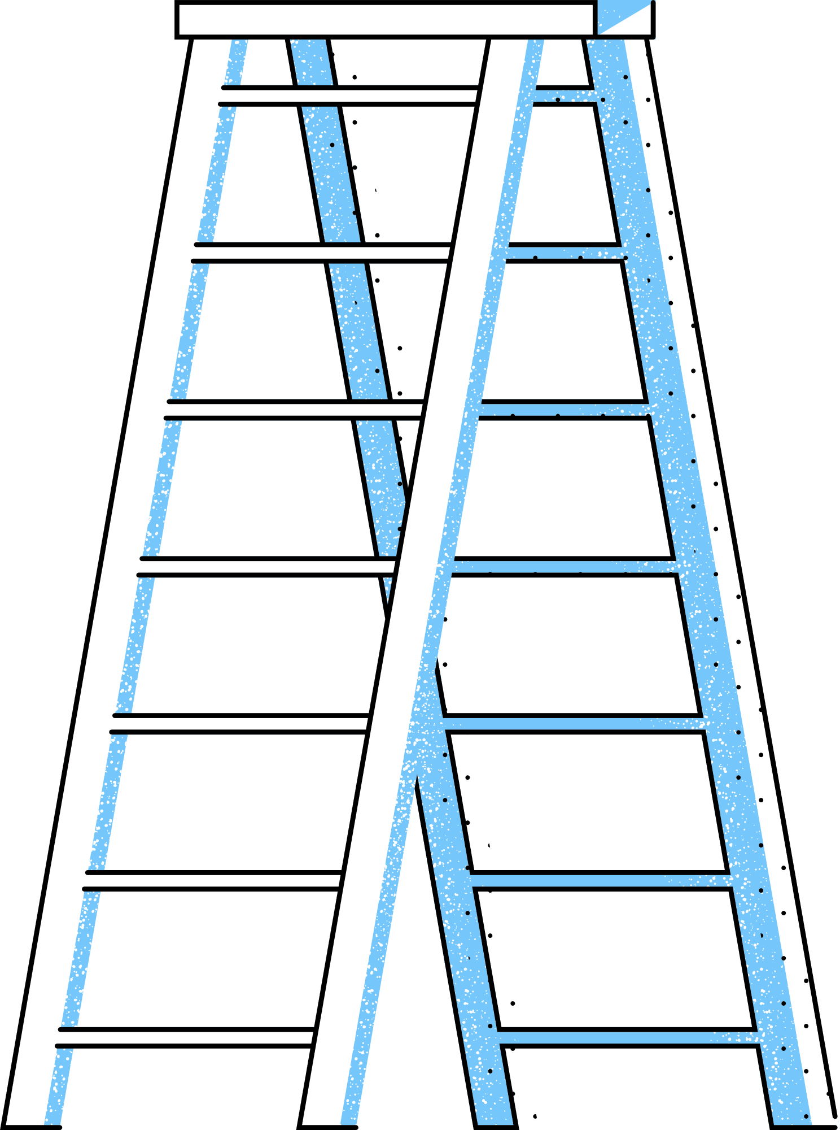
JOB EXPLORATION COUNSELING
WORK-BASED
LEARNING EXPERIENCE
COUNSELING ON
POST-SECONDARY
EDUCATION
OPTIONS
WORKPLACE
READINESS TRAINING
INSTRUCTION ON
SELF-ADVOCACY
PRE-ETS
SERVICES
TOGETHER WE CAN BUILD A FUTURE

Slide 10
WHAT IS IT?
Job Exploration Counseling focuses on helping students learn about in-demand industry sectors and occupations, non-traditional employment opportunities, the labor market, and vocational interest inventories, as well as helping them identify potential career pathways students may take based on their interests.
JOB
EXPLORATION
COUNSELING
TOGETHER WE CAN BUILD A FUTURE

Slide 11
GOALS
Determine skills, aptitudes, interests
Identify viable employment and/or independent living services options
Explore labor market, wage information, and jobs/careers in the community
Identify the physical demands and other job characteristics
Narrow vocational options to identify suitable employment goal
Use career interest inventories and self-assessments for early career-planning
Input for personal plan for study as well as four/five year plans
TOGETHER WE CAN BUILD A FUTURE
JOB EXPLORATION COUNSELING

Slide 12
WHAT IS IT?
Work-Based Learning Experience is a coordinated program that helps students with job training and informational interviews to research employers. WBLE aims to help students gain the necessary skills they need in order to succeed in a competitive and integrated workplace environment.
TOGETHER WE CAN BUILD A FUTURE
WORK-BASED
LEARNING
EXPERIENCES

Slide 13
WHAT IS IT?
Counseling on Post-Secondary Education Programs emphasizes on continuous education and professional development. With a focus on instructions students to gain awareness on the wide range of career pathway options –and in collaboration with our partners like NMC and NMTECH, this service aims to help students connect the present to the future.
TOGETHER WE CAN BUILD A FUTURE
COUNSELING ON
POST-SECONDARY
EDUCATION OPTIONS

Slide 14
GOALS
Help students understand how postsecondary education is different from secondary education
Inform students of short and long-term postsecondary training programs
Inform students of how to avail of disability support services
Research degree or credential requirements for jobs within their chosen career pathway of interest
Assist them in understanding the financial aid process.
TOGETHER WE CAN BUILD A FUTURE
COUNSELING ON
POST-SECONDARY
EDUCATION OPTIONS

Slide 15
WHAT IS IT?
Work Readiness Training helps students identify the various traits and expected skills that employers seek from most employees which include developing social skills, independent living, communication and interpersonal skills, financial literacy, orientation and mobility skills, job-seeking skills and employer expectations on punctuality and performance.
TOGETHER WE CAN BUILD A FUTURE
WORKPLACE
READINESS
TRAINING

Slide 16
SPECIFIC SOCIAL AND INTERPERSONAL SKILLS
Communication
Positive Attitude
Teamwork
Problem Solving
Talking and Writing
Cooperation
Active Listening
Decision Making
Conflict Resolution
Body Language
Empathy
Professionalism
Good Manners
Supporting Colleagues
Respectful
TOGETHER WE CAN BUILD A FUTURE
WORKPLACE
READINESS
TRAINING

Slide 17
WHAT IS IT?
Instruction on Self-Advocacy refers to an individual's ability to effectively communicate, convey, negotiate or assert his/her own interest and/or desires. This means the SELF-DETERMINATION that individuals with disabilities have the freedom to plan their own lives, pursue their own goals, and experience the same opportunities as other people within the community.
TOGETHER WE CAN BUILD A FUTURE
INSTRUCTION ON
SELF-ADVOCACY

Slide 18
SELF-ADVOCACY SKILLS
Self-awareness and Self-determination
Having an understanding of one's disability
Disclosing that disability when needed
Decision-making and Goal-setting
Evaluating options
Requesting and utilizing accommodations
Knowing rights and responsibilities
Knowing how to request and accept help
GOALS
TOGETHER WE CAN BUILD A FUTURE
Help students learn how to effectively lead their IEP, 504, or other individual planning meeting
Build skills to demonstrate that self-advocacy occurs anytime, anywhere
Increase the ability to help them be vocal about their needs
INSTRUCTION ON
SELF-ADVOCACY

Slide 19
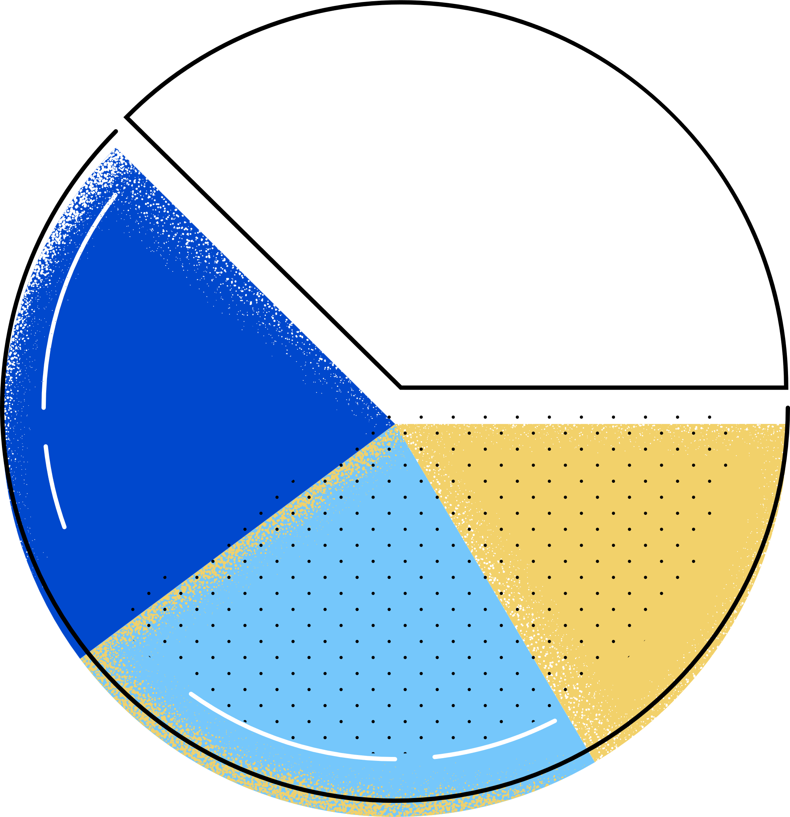
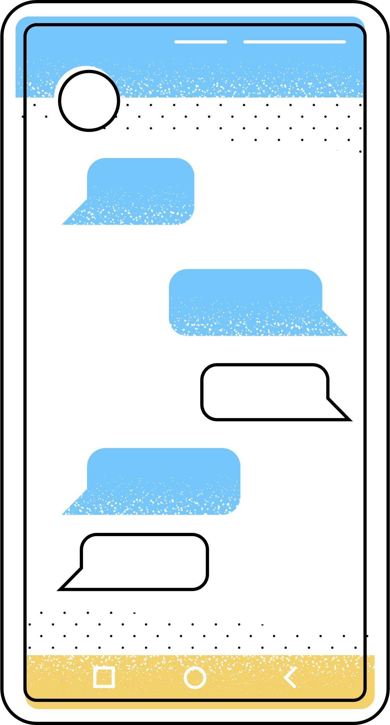
ELIGIBILITY
ENROLLED IN AN EDUCATIONAL PROGRAM (HIGH SCHOOL, COLLEGE, OR VOCATIONAL INSTITUTE)
To be eligible, one must meet the following requirements:
16-21 YEARS OF AGE
ELIGIBLE FOR, AND RECEIVING SPECIAL EDUCATION SERVICES
OR RELATED SERVICES
A STUDENT WITH A DISABILITY FOR PURPOSES OF SECTION 504 OF THE REHABILITATION ACT
TOGETHER WE CAN BUILD A FUTURE

Slide 20
TOGETHER WE CAN BUILD A FUTURE
BASIC SUPPORT/
SUPPORTED
EMPLOYMENT (BS/SE)
BS/SE is an employment-based program that serve individuals that want to gain and/or maintain employment to become independent, productive members of society.

Slide 21
ORIENTATION
INITIAL INTERVIEW
ASSESSMENT
ELIBILITY/INELIGIBILITY
INDIVIDUAL PLAN OF EMPLOYMENT (IPE)
TOGETHER WE CAN BUILD A FUTURE
OVERVIEW
PROCESS
PROVISION OF SERVICES
EMPLOYMENT
SUCCESSFUL CLOSURE

Slide 22
PHYSICAL OR MENTAL DISABILITY
ELIGIBILITY
DISABILITY MUST BE A SUBSTANTIAL IMPEDIMENT TO EMPLOYMENT
To be eligible, one must meet the following requirements:
MUST REQUIRE VR SERVICES
U.S. CITIZEN OR
GREEN CARD HOLDER
(5-YEAR BARRING PERIOD)
QUALIFIED ALIEN
AT LEAST 16 YEARS OF AGE

Slide 23
ASSSESSMENT
FOR ELIGIBILITY
VR COUNSELING,
GUIDANCE,
AND REFERRALS
VOCATIONAL
AND OTHER
TRAINING SERVICES
(Work-Experience Training (WET)
or On-the-Job Training (OJT))
COLLEGE / TRADES SCHOOL
BS/SE
SERVICES
TO INDIVIDUALS
JOB SEARCH, PLACEMENT ASSISTANCE, AND RETENTION SERVICES
ASSISTIVE TECHNOLOGY/
AND OTHER SERVICES DEEMED NECESSARY
TOGETHER WE CAN BUILD A FUTURE

Slide 24
CONSULTATION FOR
"REASONABLE JOB ACCOMMODATIONS
DISABILITY EMPLOYMENT
TRAINING AND PD,
AWARENESS, SENSITIVITY, ADA
EMPLOYMENT TRAINING
SERVICES (VIA WET/OJT)
BS/SE
SERVICES
TO EMPLOYERS
ASSISTIVE TECHNOLOGY ASSESSMENTS
INFORMATION
AND REFERRAL TO
COMMUNITY PROGRAMS
TOGETHER WE CAN BUILD A FUTURE

Slide 25
COMPETITIVE EMPLOYMENT
Earning wages at or above minimum wage with similar benefits provided to employees without disabilities
TOGETHER WE CAN BUILD A FUTURE
INTEGRATED EMPLOYMENT
THE BOTTOMLINE?
Workers with and without disabilities.

Slide 26
OFFICE OF THE GOVERNOR
OFFICE OF VOCATIONAL
REHABILITATION
TRANSITION
SERVICES
SAMUEL DAVID F. SANTOS
OVR Transition Specialist
TOGETHER
WE CAN BUILD
A FUTURE

Slide 27
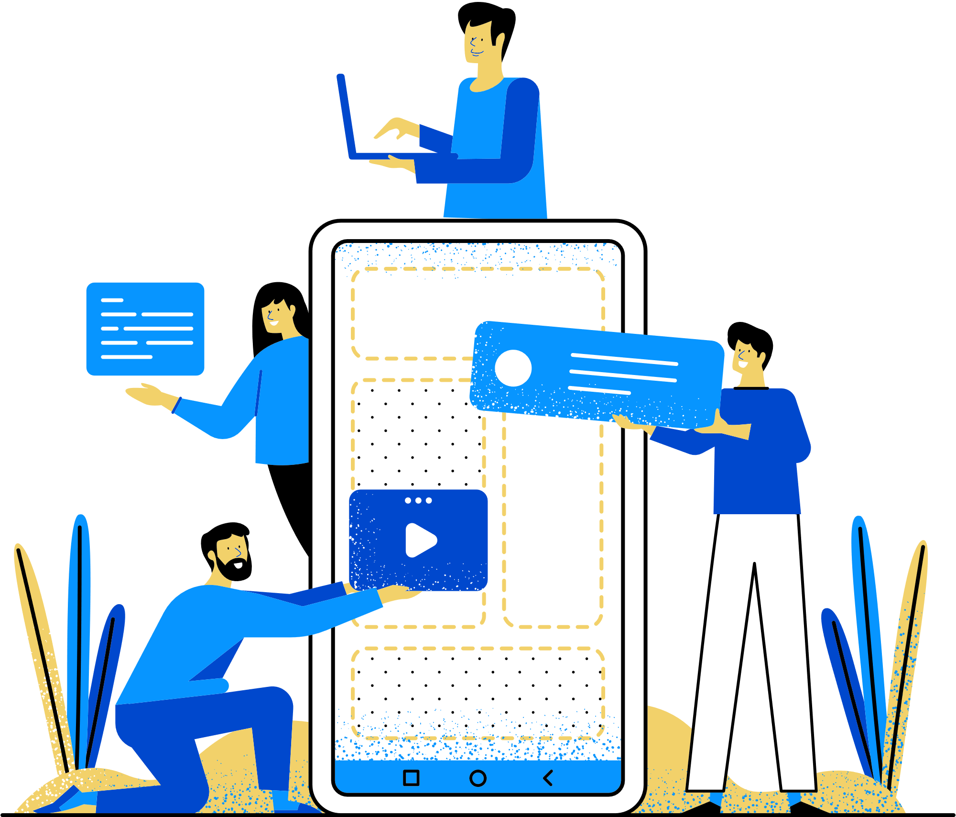
CONTACT US!
1(670)322-6537/38/39
FOR SAM (Transition & Pre-ETS)
samuel@ovrgov.net
VISIT US AT
www.ovrgov.net
ADD US TOO ON FACEBOOK!
Cnmi Ovr
FOLLOW US ON TIKTOK!
Cnmi Ovr

