Slide 1
Disability Laws & Job Accommodation Sharleen Sablan Luis Macaranas NMPASI

Slide 2
NMPASI
Northern Marianas Protection & Advocacy System Inc
Established in 1993
“To Protect the civil, legal, and human rights of individuals with disabilities”
Goals
Provide legally based advocacy services for people with disabilities and their families in the CNMI
Advance the understanding of P&A services and other disability related issues in the CNMI
Voices For those who are unable to speak

Slide 3
Learning Goal and Objectives
Goals
Ensure all members of the community are treated with dignity and respect to create an environment free from disability related discrimination and harassment.
Objective
What is a disability
Have a basic understanding Laws that protect individual with disabilities
Basic Understanding of the Family Medical Leave Act (FMLA)
What are reasonable accommodation
Employee Privacy

Slide 4
Why is this presentation important
There are 2,949 people with disability in the CNMI, that 5% of the total population
Out of the CNMI disability population 18% or 1905 are within the legal age group of employment.
People with disabilities in the United States, making up an estimated 20% of the total population.
There are 133 million people in the United States living with a chronic health condition. That number is expected to increase to 150 million by 2030
Attitudes and stereotypes remain the main barriers to successful employment reported by people with disabilities.

Slide 5
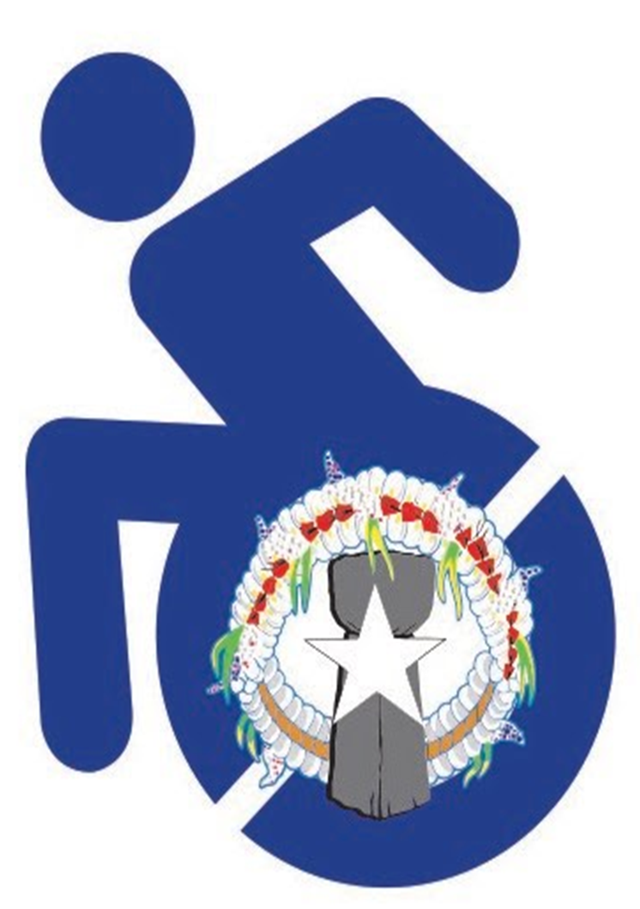
What is a disability?
The ADA defines a person with a disability as a person who has a physical or mental impairment that substantially limits one or more major life activity. This includes people who have a record of such an impairment, even if they do not currently have a disability. It also includes individuals who do not have a disability but are regarded as having a disability. The ADA also makes it unlawful to discriminate against a person based on that person’s association with a person with a disability.
Record of such an impairment, even if they do not currently have a disability.
Regarded as having a disability.
Person’s association with a person with a disability.

Slide 6
LAWS TO KEEP IN MIND
American with Disability Act
Rehabilitation Act
Vietnam Era Veterans’ Readjustment Assistance Act

Slide 7
American with Disability Act (ADA)
The Americans with Disabilities Act (ADA) prohibits discrimination against people with disabilities and guarantees equal opportunities for individuals with disabilities in employment, transportation, public accommodations, state and local government services, and telecommunications.
Title I: Employment prohibits covered employers from discriminating against people with disabilities in all employment-related activities, including hiring, pay, benefits, firing and promotions.
Title II: State and Local Governments protects people with disabilities from discrimination in state and local government services, programs and activities.
Title III Public Accommodation & Commercial Facilities prohibits discrimination on the basis of disability in the activities of places of public accommodations

Slide 8
Rehabilitation Act
The Rehabilitation Act authorizes funding for various disability-related purposes and activities, including state vocational rehabilitation (VR) programs, independent living programs, training and research, and the work of the National Council on Disability
Section 501 of the Rehabilitation Act prohibits federal employers from discriminating against qualified individuals with disabilities and requires them to take affirmative action to employ and advance in employment qualified individuals with disabilities.
Section 503 of the Rehabilitation Act prohibits employment discrimination based on disability and requires affirmative action in the hiring, placement and advancement of people with disabilities by federal contractors or subcontractors who have federal contracts or subcontracts in excess of $10,000.
Section 504 of the Rehabilitation Act prohibits discrimination against qualified individuals with disabilities by federal agencies, or by programs or activities that receive federal financial assistance or are conducted by a federal agency.

Slide 9
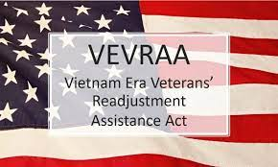
Vietnam Era Veterans ‘ Readjustment Assistance Act (VEVRAA)
The Vietnam Era Veterans' Readjustment Assistance Act (VEVRAA) requires employers that have federal contracts or subcontracts entered into before December 1, 2003 of $25,000 or more and/or federal contracts or subcontracts entered into on or after December 1, 2003 of $100,000 or more to provide equal employment opportunities for certain veterans with disabilities. VEVRAA's Section 4212 specifically prohibits discrimination against covered veterans with disabilities in the full range of employment activities.

Slide 10
Family Medical Leave Act
The Family and Medical Leave Act (FMLA) provides certain employees with up to 12 weeks of unpaid, job-protected leave per year. It also requires that their group health benefits be maintained during the leave.
FMLA is designed to help employees balance their work and family responsibilities by allowing them to take reasonable unpaid leave for certain family and medical reasons.
Twelve workweeks of leave in a 12-month period for:
To take medical leave when the employee is unable to work because of a serious health condition.
For the birth and care of the newborn child of an employee;
For placement with the employee of a child for adoption or foster care;
To care for an immediate family member (i.e., spouse, child, or parent) with a serious health condition

Slide 11
FMLA Cont
Employee that qualify
Work for a covered employer
Work a total of 1,250 hours during the prior to the start of leave
Work at a location where 50 or more employees work at the location or 75 miles of it
Have worked for an employer for 12 months.
Military- Uniformed Service Employment and Reemployment Rights Act of 1994 (USERRA)

Slide 12
FMLA cont
Employers that Qualify
Private sector Employers
If it employs 50 or more employees in 20 or more workweek in the current or previous calendar year
Public Agency
Public agencies are covered under FMLA, regardless of the number of employees they employ
Federal Government
USPS
Postal Regulatory commission
Federal Aviation Administration
The judicial branch of the United States
Schools
Public school boards
Public elementary and secondary schools
Private elementary and secondary school

Slide 13
What are reasonable accommodations?
A reasonable accommodation is any modification or adjustment to a job, practice, policy, or the work environment that allows an individual with a disability to participate equally in an employment opportunity.
Examples include:
Making existing facilities accessible
Modifying a work schedule
Altering training materials, tests, or policies
Acquiring or modifying equipment
Providing an interpreter
Restructuring a job
Leave without pay
Reassignment to a vacant position

Slide 14
Thing to keep in mind about Accommodation
Preferred vs. Effective
Undue hardship
Personal service or device
Removing essential functions

Slide 15
Scenario: Maria
Si Maria, a computer specialist, has fibromyalgia and experiences flare ups of major fatigue and pain affecting her ability to perform manual tasks such as walking and daily household chores. She has requested a flexible work schedule and the ability to work from home which would require the use of a computer and remote access.
-Are Maria requests reasonable?
-What if Maria’s job was a line cook? Would her request for a flexible work schedule and ability to work from home be reasonable?

Slide 16
Scenario: Juan
Juan, a receptionist, recently lost most use of his right arm. He informs his supervisor that performing certain office tasks takes him much longer with his left hand. His supervisor replied that Juan still needs to meet deadlines.
-Did Juan request an accommodation?
-Did the employer engage in the interactive process?
-Does Juan have to meet the deadlines with or without a reasonable accommodation?

Slide 17
Employee Privacy: Medical Information
Medical information is not shared with a supervisor
Accommodation information is shared on a need-to-know basis
Co-workers not entitled to any medical information
Human Resources stores all medical Information

Slide 18
Employee Privacy: Medical Inquiries
Applicants
No questions about medical status, medical history, disabilities, or severity of any medical condition
Can ask if they can perform job functions
Employees
No questions about medical status, medical history, family medical history, or specifics about disabilities or medical conditions
Tell employees that you are concerned, but you cannot discuss these issues with them for employee’s and manager’s protection
Refer to Human Resources

Slide 19
Questions ?

Slide 20
Thank you
Disability Law & Job Accommodation
Northern Marianas Protection & Advocacy System Inc (NMPASI)
Sharleen Sablan
Luis Macaranas

