Slide 1
CNMI OVR Presents on:
“Empowering Self-Advocates to
Take Charge of Their
Workplace Needs”
National Disability Employment Awareness Month
Tinian: October 14, 2021
Rota: October 19, 2021
Venue: NMC Campus

Slide 2
Self-Advocacy:
“Knowing what you want, what you do well,
and what you have difficulty doing. It includes:
knowing your legal rights
your needs
and telling that information to the
appropriate person.”

Slide 3
What does all of this mean?
COMMUNICATION…
is the key to getting your workplace
needs met.

Slide 4
Job Accommodations
It’s all about identifying your needs & asking for help.
You do not need to use special words such as “Reasonable Accommodations”…
There is also no need to mention the ADA when you are requesting for some assistance.

Slide 5
If you need help to do your job effectively,
you need to disclose your disability.
Disclosure means making the decision to tell another person about your disability.
Be ready to explain how your disability is getting in the way of you doing your job effectively, and offer some accommodation ideas of your own.

Slide 6
Disclose to:
Your supervisor
HR department
Note: If you do not require an accommodation, then there is no reason to disclose your disability.

Slide 7
Example 1:
Tom has ADHD.
He asks his supervisor for a private office to lessen distractions at work.
Is this a reasonable accommodation? YES

Slide 8
Example 2:
Sara is a Data Entry Clerk.
She has low vision.
Sara requested for assistive technology that can help her work on a computer more effectively.
Is this a reasonable accommodation? YES

Slide 9
Disclosing your disability can happen
At any time during the employment process:
Application
Interview
People disclose at different times depending on their needs!

Slide 10
Keep in mind:
If you are working for a company, and your disability is starting to get in the way of you performing to the best of your abilities, then it might help to disclose your disability before any performance issues occur.
Note: When having this discussion with your supervisor, remember to also talk about your abilities.

Slide 11
How to disclose your disability:
Best to submit your accommodation request in writing.
Next slide: Sample Accommodation Request Letter from the Job Accommodations Network (JAN)

Slide 12
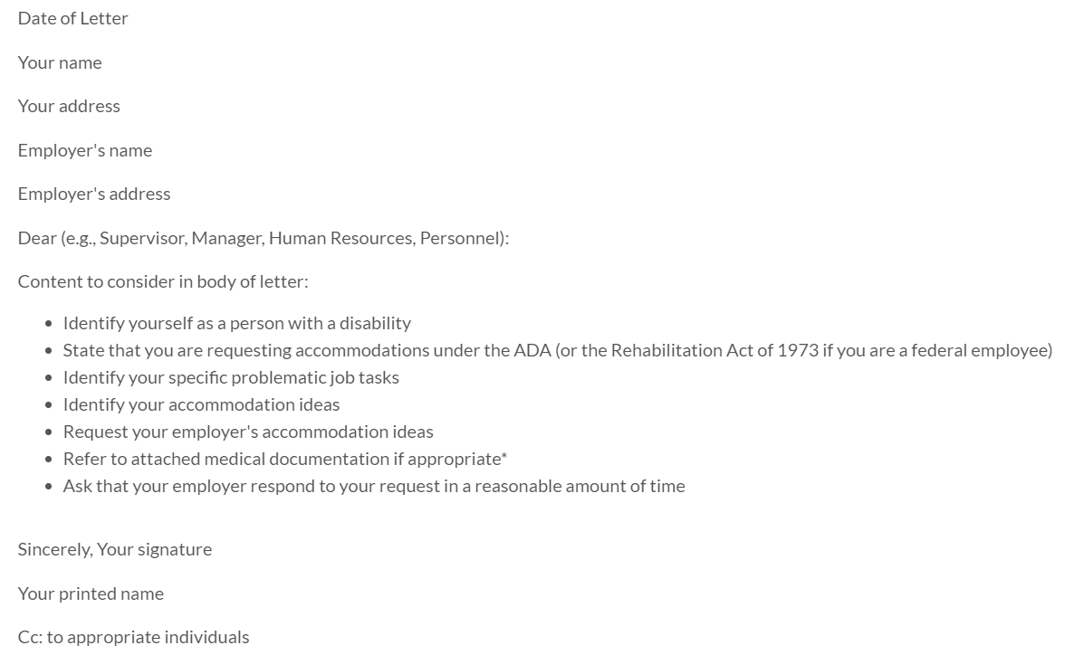

Slide 13
Interesting Facts
Reasons why some employees do not disclose their disability:
Lack self-advocacy skill
No support
Fear discrimination

Slide 14
Helpful Tips
Understand yourself well (your disabilities, abilities, accommodation needs, etc.)
Have a good idea of how you can meet job-related challenges
Learn some self-advocacy skills (when and how to disclose your disability)

Slide 15
Helpful Tips…continuation
Empower yourself to take charge of your life and your needs
Learn your rights under the ADA (check out JAN)
Be ready to share disability documentation
Ask yourself: How can technology help me do the job I want to do?

Slide 16
**Americans with Disabilities Act (ADA)**
Protects the rights of individuals with disabilities
Covers employment practices from:
recruitment to pay and all other activities in between
Employment discrimination is also covered
under the ADA.

Slide 17
Contact Information:
Office of Vocational Rehabilitation
Mailing Address: P.O. Box 501521, Saipan, MP 96950
Phone: (670) 322-6537 or 322-6538
Email: nmidir@ovrgov.net
Website: www.ovrgov.net
Facebook: CNMI OVR

Slide 18
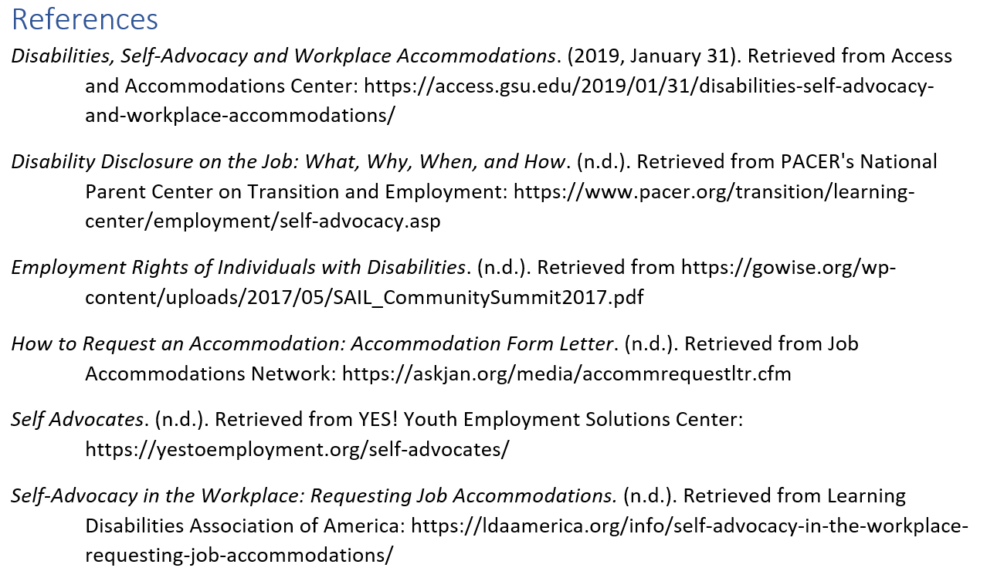

Slide 19
Thank you for being here with us today!

